Slide 1
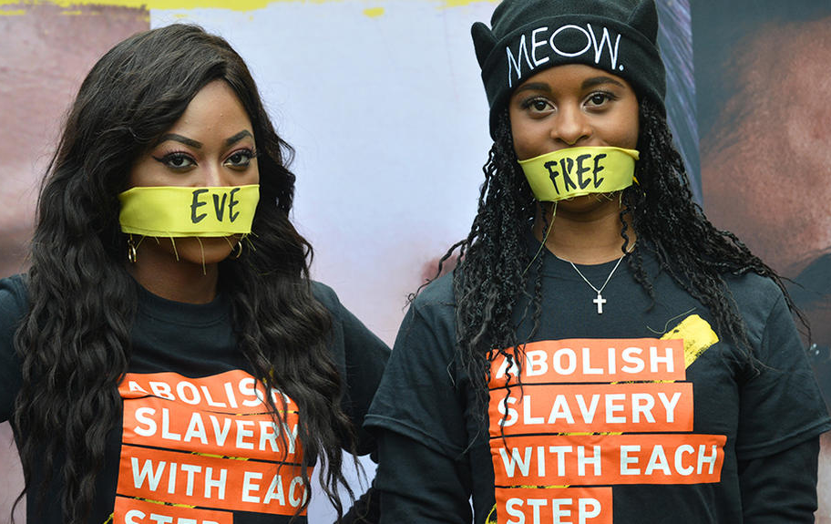
Bill S211
FORM-S211-001
Employee Training
Protest against modern slavery in London, 14 October 2017.
©Mathew Chattle/ Barcroft Media/ Getty Images
Author:QA techniciam, Reviewers: QA department Published le 2024-03-01

Slide 2
Important Definitions

Slide 3
Forced labour
Forced labour is defined by the International Labour Organization as "any work or service exacted from an individual under threat of any penalty and for which the individual has not voluntarily offered himself". Forced labour includes all forms of modern slavery, debt bondage and most human trafficking offences.

Slide 4
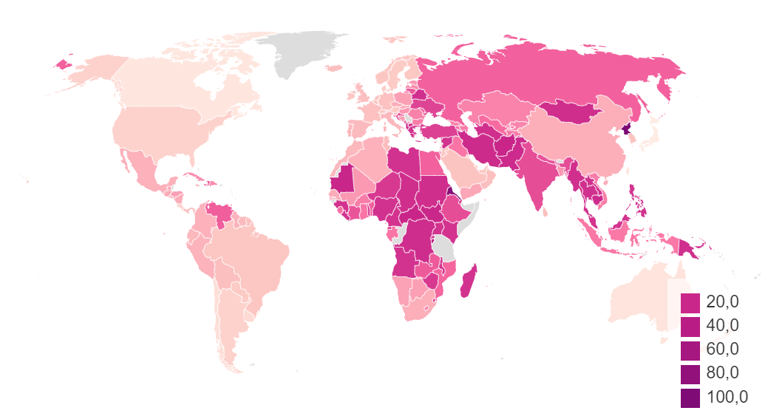
Forced labour - continued
It is important to note that Canada is not free of forced labour. Immigrants and sex workers are often the most affected.
The index of slavery in the world per 1000 inhabitants.

Slide 5
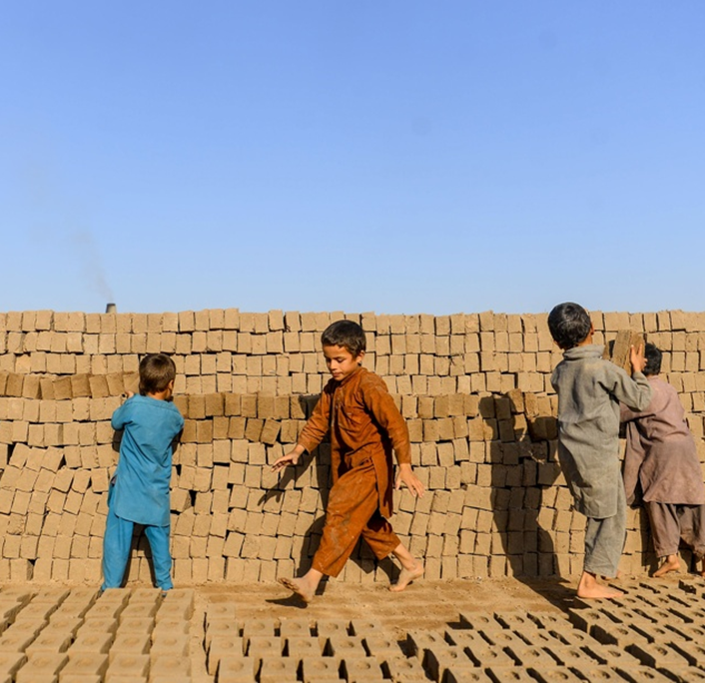
Child labour
Child labour refers to work that is mentally, physically or socially dangerous and harmful to children; and that compromises their schooling.
This does not include regular household chores, after-school work, or light, age-appropriate work that can benefit the child's development.
PHOTO HOSHANG HASHIMI, ARCHIVES AGENCE FRANCE-PRESSE

Slide 6
Child labour - continued
National law defines child labour according to the context of each country, although the International Labour Organization indicates minimum ages for different types of employment: 13 years for light work, usually up to 14 hours of work per week; 15 years for ordinary work, usually up to 43 hours of work per week. 18 years for hazardous work; Hazardous work may include night work and long working hours, exposure to psychological, physical or sexual abuse, working in hazardous or unhealthy environments; and/or work with hazardous equipment or machinery.

Slide 7
Fundamental human rights
Freedom of thought, opinion, expression or religion, and the right not to be discriminated against, such as discrimination based on ethnicity, age, nationality, gender or sexual orientation, or any form of harassment.
https://helenechristodoulou.com/la-protection-des-droits-fondamentaux-face-au-parquet-europeen

Slide 8
Bill S-211
In 2021, with Bill S-211, An Act to enact the Fighting Against Forced Labour and Child Labour in Supply Chains Act and to amend the Customs Tariff, Canada wanted more transparency from company doing business in Canada by forcing them to publish what they are doing to reduce the risk of forced and child labour in their supply chains.

Slide 9
History of Bill S-211

Slide 10
Modern Slavery
Modern slavery includes all the definitions listed above.
Several countries are already involved in preventive and corrective measures against forced labor and child labor in supply chains. Several laws have been passed over the years. Canada was slow to introduce its own (Bill S-211), which came into effect in January 2024.

Slide 11
Modern Slavery - continued
Following the renegotiation of the 2020 Canada-United States-Mexico Agreement (NAFTA), Canada adopted "measures" to prohibit the import of goods produced in whole or in part through the use of forced labour, including forced child labour. Canada gave effect to this prohibition by amending the Customs Tariff accordingly. However, no concrete indications have been provided and these measures have not been implemented. Therefore, to strengthen this agreement, Bill S-211 was passed.

Slide 12
Laws in other Countries

Slide 13
Other Modern Slavery Laws
Transparency in supply chains and efforts to eradicate child labour and forced labour.
Transparency in Supply Chains Act of (2010, Californie)
Modern Slavery Act 2015 (United Kingdom)
Loi relative au devoir de vigilance (2017,France)
MODERN SLAVERY ACT (2018, Australie)
Directive concernant la publication d’informations non financières (2014, Union européenne)
Wet Zorgplicht Kinderarbeid (2019, Pays-Bas)
L’Accord Canada-États-Unis-Mexique (ACEUM) (2020)
Uyghur Forced Labour Prevention Act (2021,États-Unis)

Slide 14
Bill S-211

Slide 15
Obligations: a report made public
The Act requires an annual report to be submitted to the Minister of Public Safety and Emergency Preparedness. This report must also be made public on the entity's website. In their report, companies must document their efforts to:
implementing policies, training, protocols for onboarding new suppliers and contract fulfillment mechanisms, as required; analyze their supply chain and conduct due diligence to identify risks of forced and child labour; Adopt compliance, monitoring, and remediation measures

Slide 16
Offences
Offence
Anyone who fails to comply with sections 11 or 13 (make the annual report public) is guilty of an offence and liable on summary conviction to a fine of up to $250,000.
False or misleading statement or information
Every person who knowingly makes a false or misleading statement or provides false or misleading information to the Minister or designated person is guilty of an offence and liable on summary conviction to a fine not exceeding $250,000.
Criminal liability — directors, officers, etc.
Where a person or entity commits an offence under this Part, any director, officer or agent of that person or entity who directed, authorized, assented to, acquiesced in or participated in the commission of the offence is a party to and guilty of the offence and is liable on conviction to the punishment provided for the offence, whether or not the person or entity has been prosecuted or convicted.
Perpetration by an employee or agent
In prosecutions for an offence, it is sufficient to establish the guilt of the accused to prove that the offence was committed by his employee or agent, whether or not that employee or agent has been identified or prosecuted. However, no one can be found guilty of the offence if he proves that he exercised due diligence to prevent its commission.

Slide 17
QUESTIONS AND COMMENTS

